Slide 1
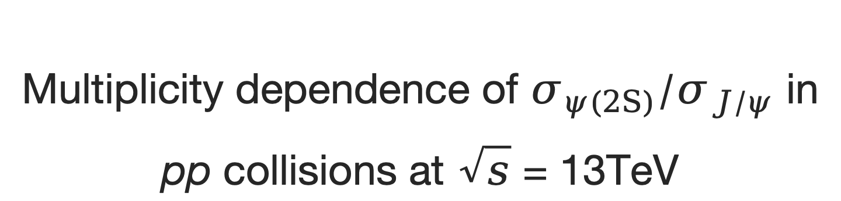
Multiplicity dependence of $σ_{ψ(2S)}/σ_{J/ψ}$ in pp collisions at $\sqrt{s}$ = 13TeV
Speaker: Youen Kang
Instructor: Xianglei Zhu
Institute: Tsinghua University
Notes:
Hello everyone
this is youen Kang from Tsinghua University
My analysis is, multiplicity dependence of psi(TwoS) to J/psi production ratio in pp collisions at center of mass energy thirteen TeV.

Slide 2
Outline
Introduction
Data Sets
Analysis
Signal extration
Efficiency
Systematic Uncertainty
Results
Notes:
This is the outline of the presentation.

Slide 3
Introduction
Notes:
First is the introduction part.

Slide 4
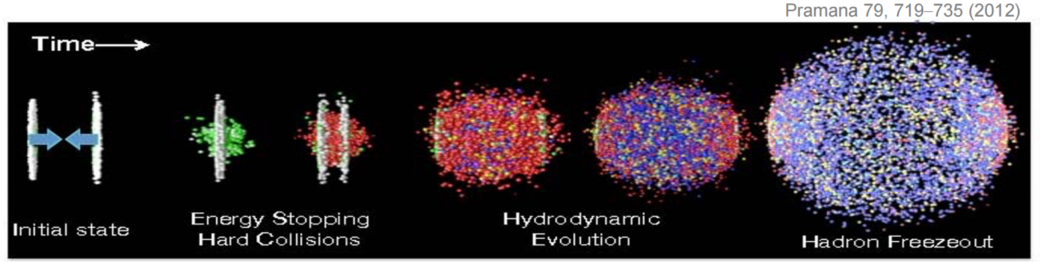
Heavy quarkonium production
Heavy quarkonium production is an excellent probe for QGP and nuclear matter effects in heavy-ion collisions.
Heavy quarks are produced in intial hard scattering.
Heavy quarks experience whole time evolution.
Notes:
Heavy quarkonium production serve as a probe for the dynamics of QCD.
Heavy quarks are generated in the initial stages, so the investigation of quarkonium production can throw lights on the evolution of heavy-ion interactions.

Slide 5
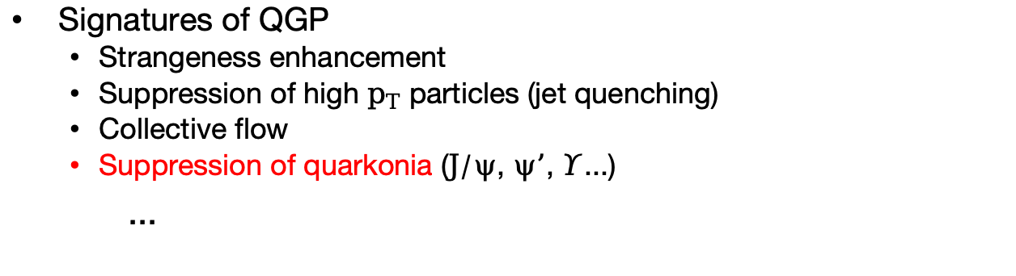
Collision systems
Collision Systems
A-A collisions: Hot Nuclear Matter (HNM) effect dominates, related to the QGP production.
p-A collisions: Cold Nuclear Matter (CNM) effect dominates, including initial-state effect like energy loss in multi-particles scattering, nuclear Parton Distribution Functions (nPDFs) and final-state effect like nuclear absorption and co-mover effect.
pp collisions: No Nuclear Matter effect expected to exist.
Large systems
Small systems
Signatures of QGP
Strangeness enhancement
Suppression of high $p_{T}$ particles (jet quenching)
Collective flow
Suppression of quarkonia ($J/ψ$, $ψ’$, $Υ$...)
...
Has been observed in Large and high-multiplicity Small systems.
Need verification
Notes:
Heavy quarkonium production is influenced by a variety of effects. These include phenomena such as suppression due to Debye Color screening in Quark-Gluon Plasma (QGP), recombination processes that lead to enhancements at higher energies.
Quarkonium production is also influenced by nuclear matter effects including initial-state effect like energy loss in multi-particles scattering, nuclear Parton Distribution Functions (nPDFs) and final-state effect like nuclear absorption and co-mover effect.
Hence, baseline measurement in pp collisions is very important, it can serve as benchmark.

Slide 6
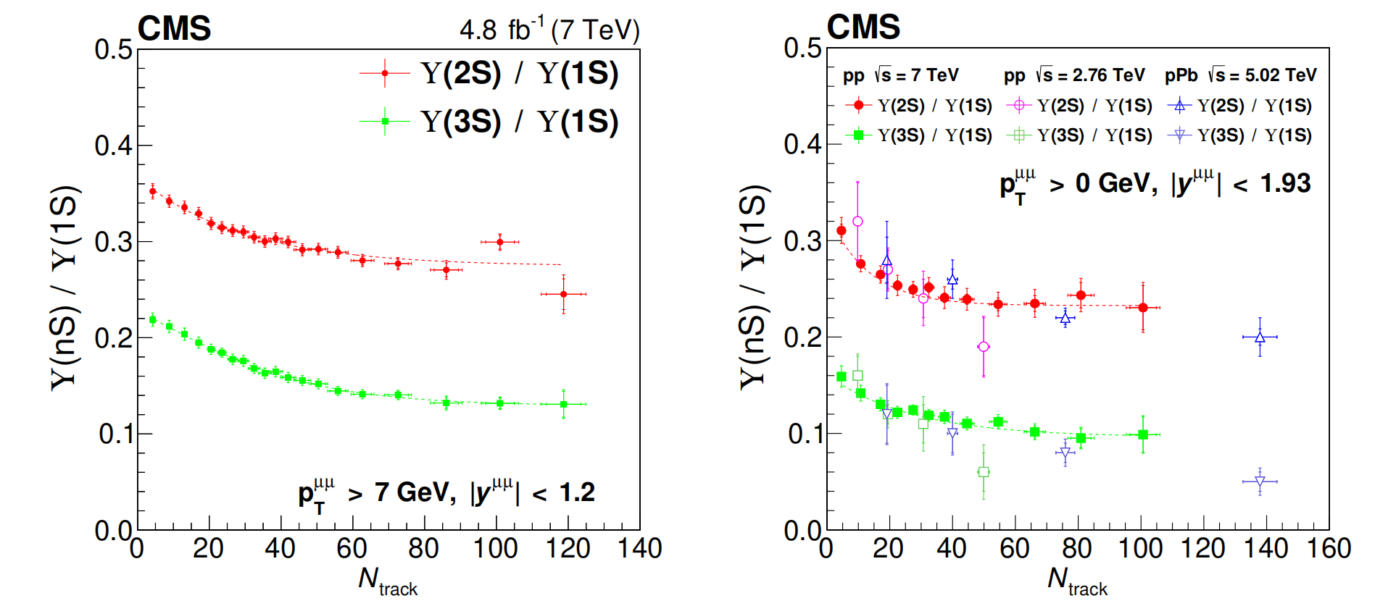
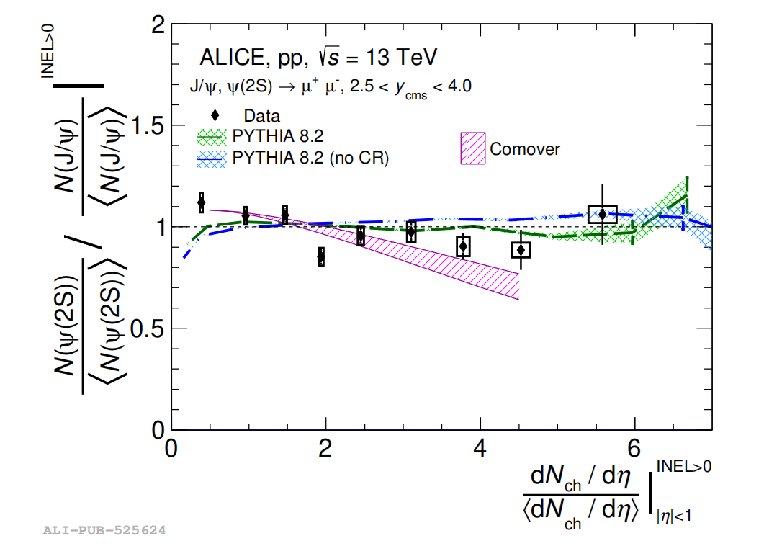
Excited-to-ground ratio of quarkonium in pp collisions
Initial-state effects like nPDFs, energy loss due to multi-particle scatterings will be canceled out.
Final state effects and potential existence of QGP need be taken into consideration.
CMS [JHEP11(2020)001]
ALICE [JHEP 06 (2023) 147]
Notes:
By considering the Excited-to-ground ratio of quarkonium in pp collisions, Initial-state effects like nPDFs, energy loss due to multi-particle scatterings will be canceled out. Final state effects and potential existence of QGP need be taken into consideration

Slide 7
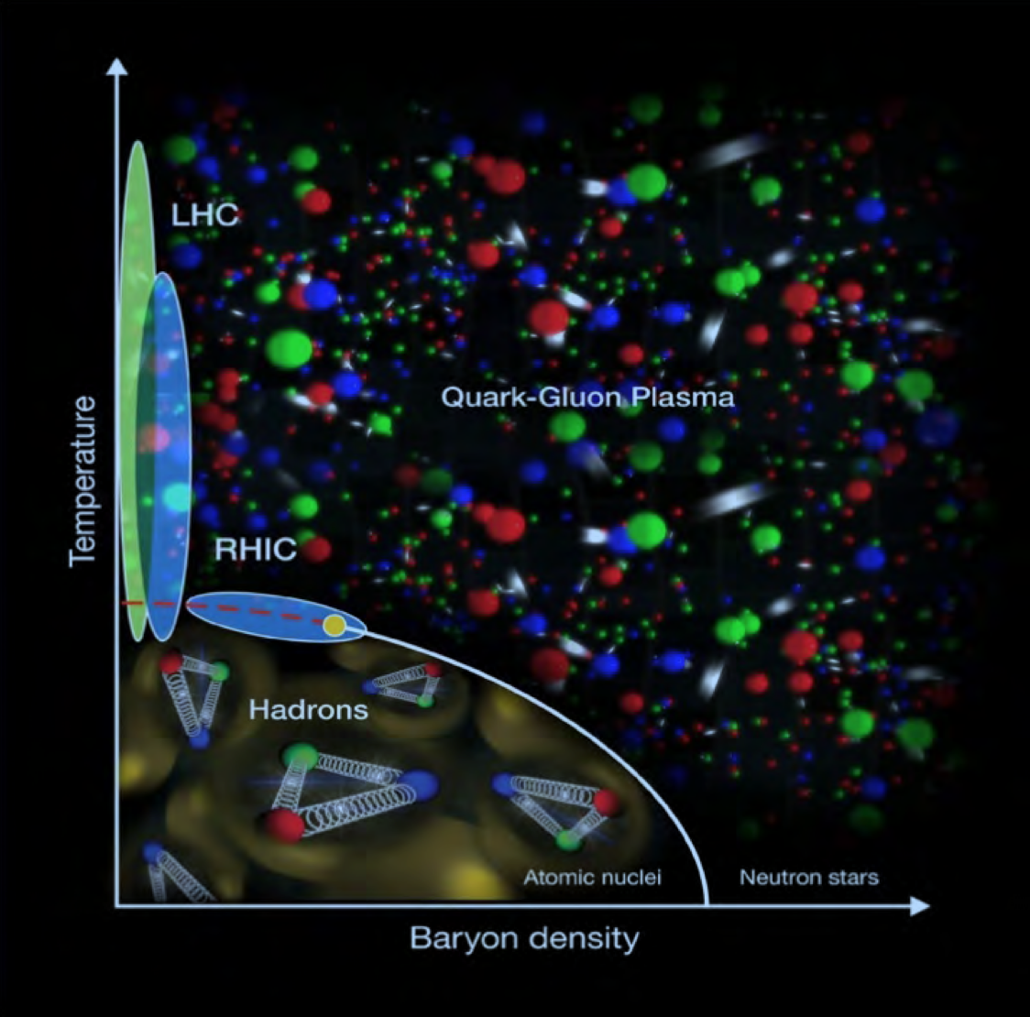
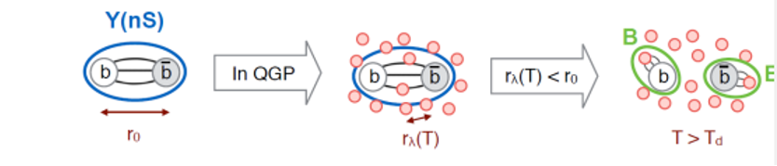
Quark-gluon plasma
Quark-Gluon Plasma (QGP):
A thermally equilibrated system where partons are deconfined from the hadrons.
Achieve either by heating or compression of nuclei.
May exist in the early stage of universe, the core of neutron stars and ultra-relativistic energy heavy ion collisions.
Color screening:
High density of free color charges leads to color screening and dissociation of heavy quarkonium.
A schematic of QCD phase diagram
Notes:
Within the extremely hot and dense matter, quarkonia tend to dissociate, especially for those at higher energy level. The color screening effect will affect the quarkonium with larger radius and lower binding energy more. Which means the excite-to ground ratio of quarkonium will be modificated within QGP.

Slide 8
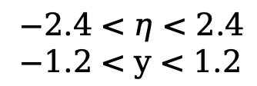
Co-mover effect
‘Quarkonia are suppressed by interaction with the co-moving medium, constituted by particles with similar rapidities.’ [JHEP 03 (2019) 063]
Multiplicity measured in: $−1<η<1$
Production measured in : $2.5<y<4$
$−2.4<η<2.4$
$−1.2<y<1.2$
Notes:
And final state effect like co-mover effects will also affect the quarkonium production differently according to the energy level. Modification from both QGP and co-mover effect are find to be dependent on the charged particle multiplicity. So in this analysis we measure the production ratio of psi2S to Jpsi as function of different multiplicity variables, to investigate any possible effect shown in the results.

Slide 9
Analysis
Notes:
Then we come to the analysis part

Slide 10
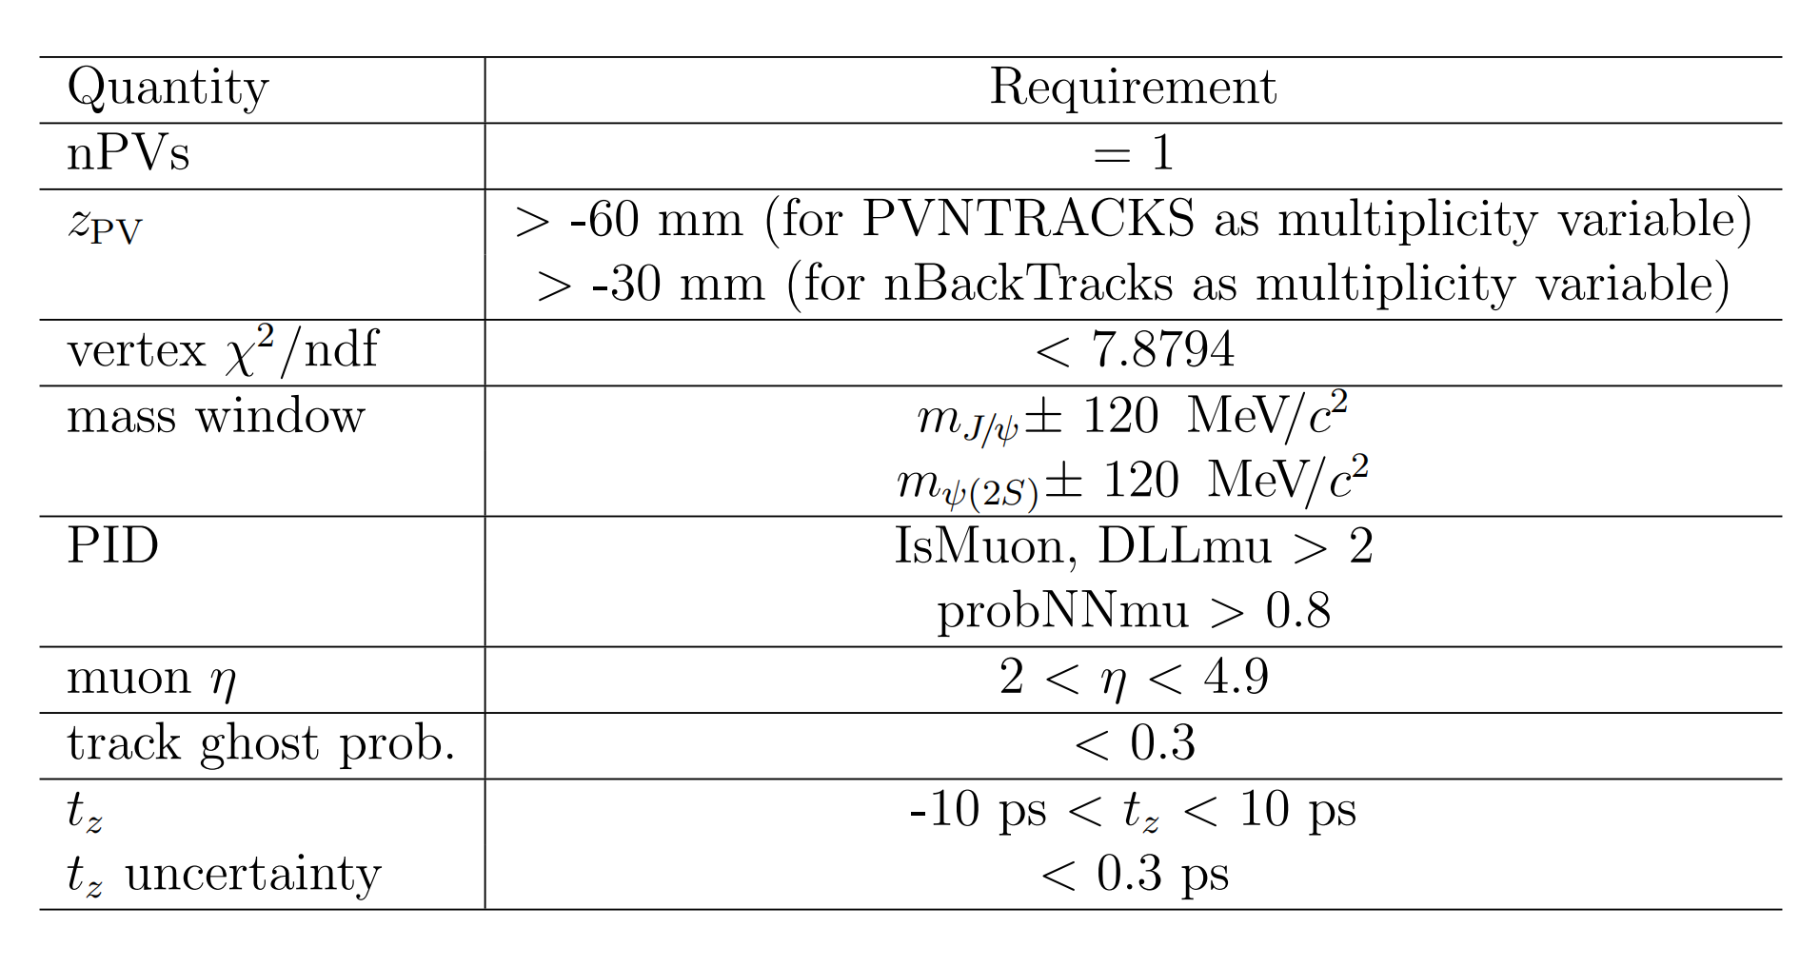

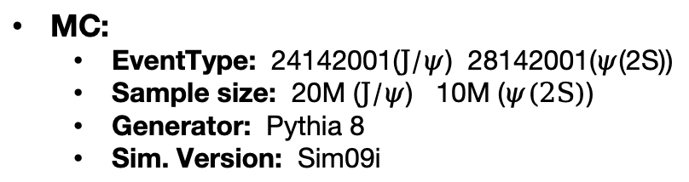
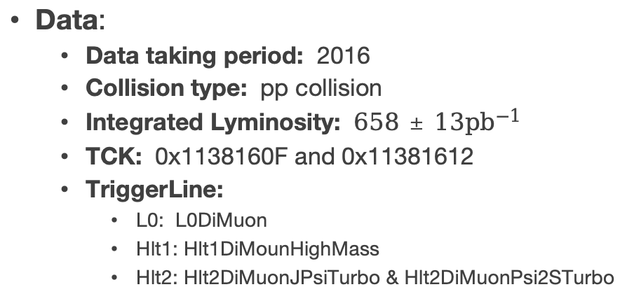
Data set
Data:
Data taking period: 2016
Collision type: pp collision
Integrated Lyminosity: $658±13{pb}^{−1}$
TCK: 0x1138160F and 0x11381612
TriggerLine:
L0: L0DiMuon
Hlt1: Hlt1DiMounHighMass
Hlt2: Hlt2DiMuonJPsiTurbo & Hlt2DiMuonPsi2STurbo
Offline selection
MC:
EventType: 24142001($J/ψ$) 28142001($ψ$(2S))
Sample size: 20M ($J/ψ$) 10M ($ψ(2S)$)
Generator: Pythia 8
Sim. Version: Sim09i
Decay Channel:
$J/ψ→μ^{+}+μ^{−}$
$ψ(2S)→μ^{+}+μ^{−}$
Notes:
The decay channels are Jpsi and Psi(TwoS) to dimuon.
The study here uses pp collision data
collected by the LHCb detector at a center-of-mass energy of Thirteen TeV in 2016
with a corresponding luminosity of six hundred and fifty-eight inverse pico barns.
To enlarge the sample size, two different TCKs with same restrictions on muon cut are applied.
The trigger line is listed and the offline selection is summarized in the right table.

Slide 11

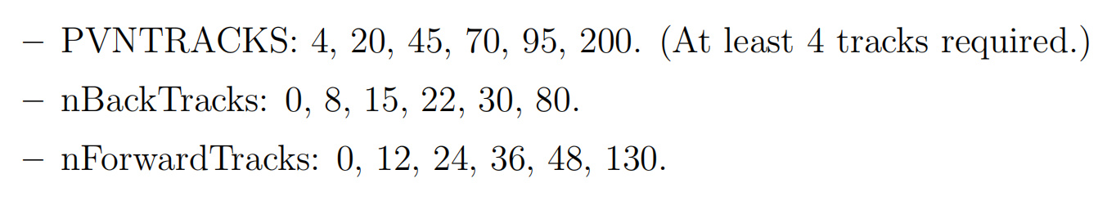
Multiplicity variables
PVNTRACKS: Number of tracks used to reconstructed primary vertex.
nForwardTRacks: Number of tracks in similar rapidity range where charmonium production is measured.
nBackTracks: Number of tracks in backward rapidity range.
Usage of nBackTracks allows to reduce the correlation of multiplicity and charmonium production measurements.
Notes:
The multiplicity variables we use here are PVNTRACKS, which represents the number of tracks used to reconstruct primary vertex, and nForwardTracks, number of tracks in similar rapidity range where charmonium production is measured, and nBackTracks: Number of tracks in backward rapidity range. The Usage of nBackTracks allows to reduce the correlation of multiplicity and charmonium production measurements.

Slide 12
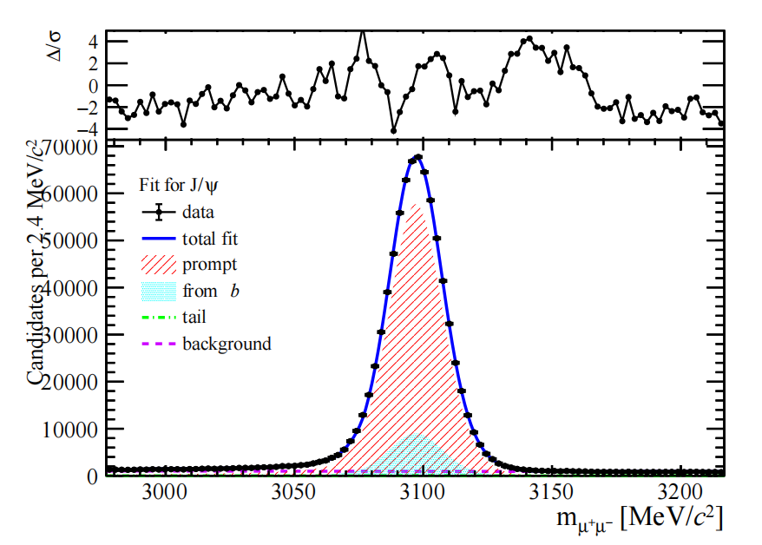
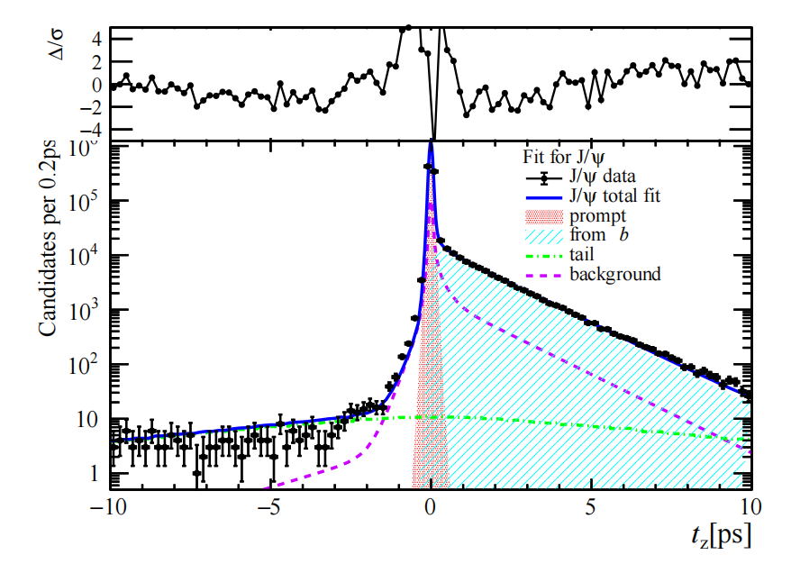
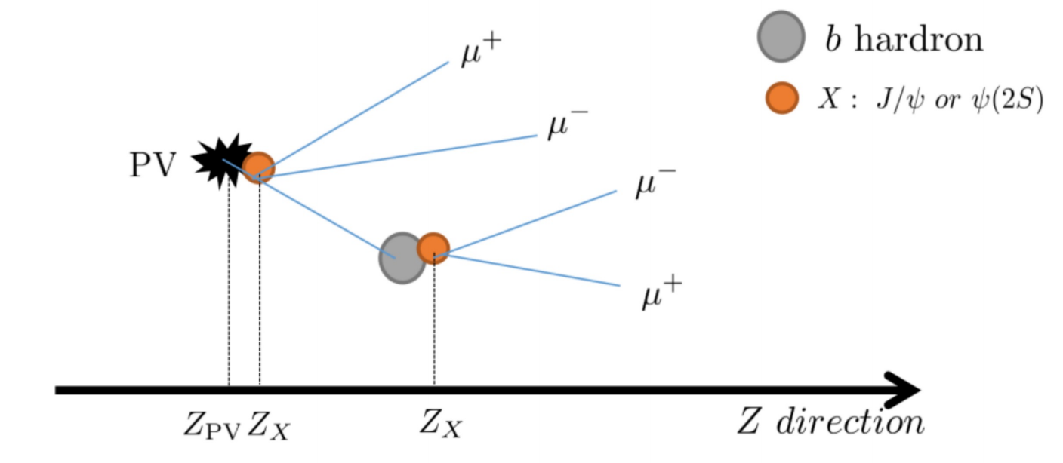
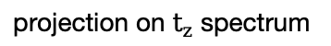
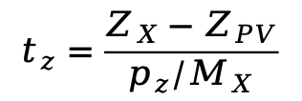
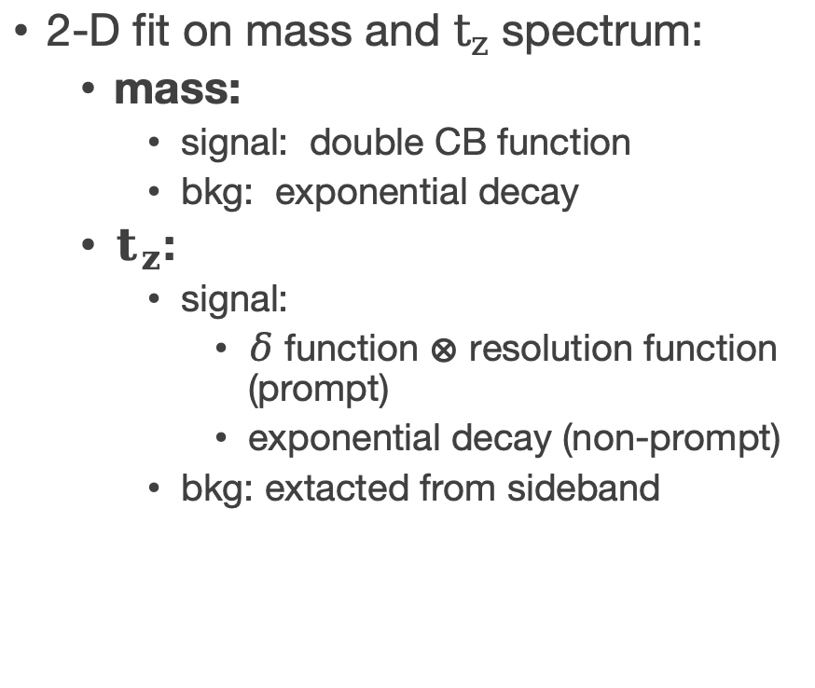
Signal extraction
2-D fit on mass and $t_{z}$ spectrum:
mass:
signal: double CB function
bkg: exponential decay
$t_{z}$:
signal:
$δ$ function $⊗$ resolution function (prompt)
exponential decay (non-prompt)
bkg: extacted from sideband
projection on mass spectrum
projection on $t_{z}$ spectrum
$$t_{z}=\frac{Z_{X}−Z_{PV}}{p_{z}/M_{X}}$$
Definition of pseudo-decay time:
Notes:
To extract the signal yields,
a two dimensional fit is performed where for mass fit,
a double crystal function is used to describe the signal and an exponential deacy to describe background.
For pseudo-decay time tz, which is defined as the following formula,
it represents the time between the production and decay of a charmonium.
The prompt signal, which is produced directly from the collisions,
is described by a delta function convolved with a resolution function.
The non-prompt signal, which comes from the decay of b-hadron,
is described by an exponential decay.
And the background shape is extrated from a sideband sample.
By the two dimension fit, we get the production of prompt and non-prompt charmonium.
On the right side is a graph for the two-dimensional fit projected in mass and tz spectrum.

Slide 13
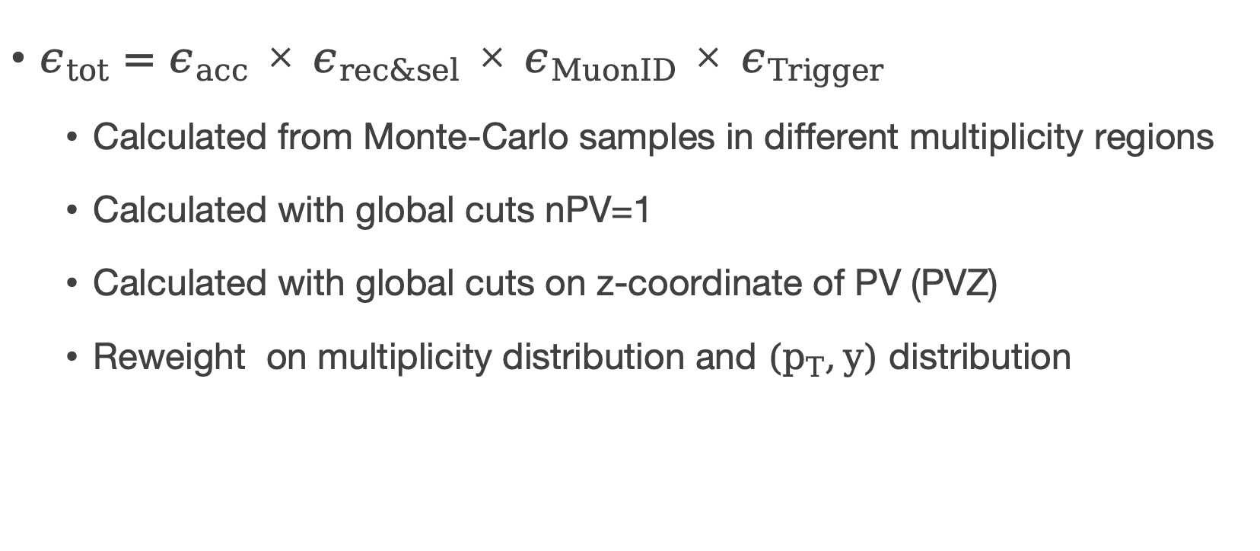
Efficiencies correction
$ε_{tot}=ε_{acc}×ε_{rec\&sel}×ε_{MuonID}×ε_{Trigger}$
Calculated from Monte-Carlo samples in different multiplicity regions
Calculated with global cuts nPV=1
Calculated with global cuts on z-coordinate of PV (PVZ)
Reweight on multiplicity distribution and $(p_{T},y)$ distribution
Notes:
The total efficiency include geometric acceptance, reconstruction and selection efficiency, muonID efficiency and trigger efficiency. The efficiencies are calcualted from simulated samples, and be calculated in different multiplicity regions. Some global cuts are applied when calculating the efficiencies, such as number of Primary Vertex is required to be exactly one, to prevent pile-up. And the range of z-coordinate of primary vertex are also be restricted to some regions according to the multiplicity variables we use. And when calculating the efficiencies, reweight on multiplicity, transverse momentum and rapidity is done to match the simulated sample to s-weighted data from fit.

Slide 14
Result
Notes:
And we get the results.

Slide 15
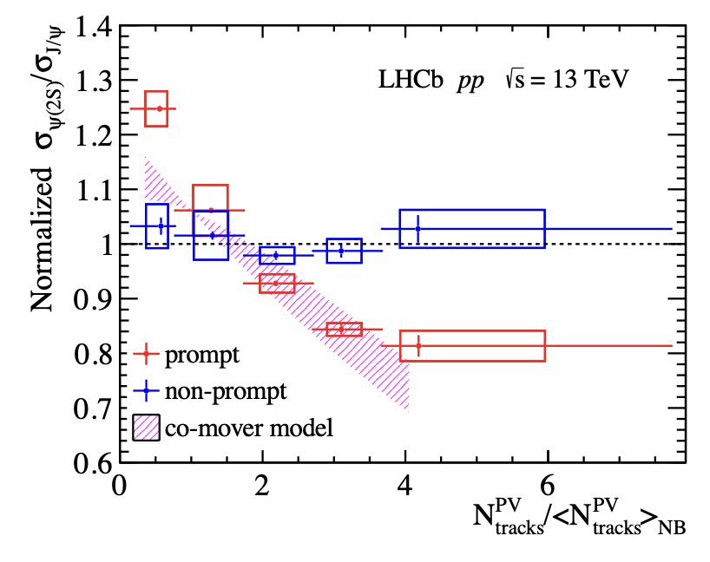
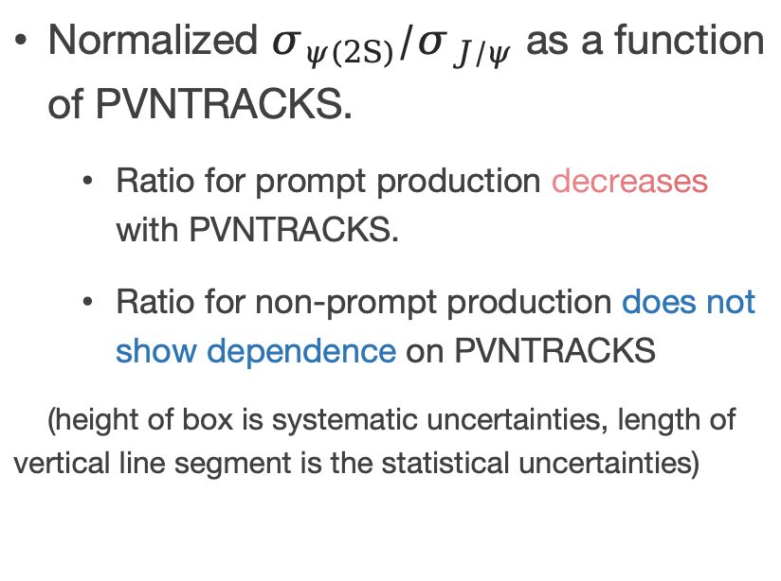
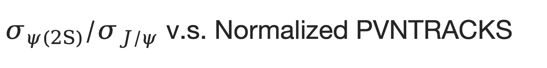
$σ_{ψ(2S)}/σ_{J/ψ}$ v.s. Normalized PVNTRACKS
Normalized $σ_{ψ(2S)}/σ_{J/ψ}$ as a function of PVNTRACKS.
Ratio for prompt production decreases with PVNTRACKS.
Ratio for non-prompt production does not show dependence on PVNTRACKS
(height of box is systematic uncertainties, length of vertical line segment is the statistical uncertainties)
Notes:
After considering all the systematic uncertainties.
We give the normalized ratio of psi(TwoS) to Jpsi production as a function of PVNTRACKS in the right graph.
PVNTRACKS on the x-axis is re-scaled by dividing the mean value of PVNTRACKS from no-bias data.
The height of box is systematic uncertainties, length of vertical line segment is the statistical uncertainties
We can clearly see that the ratio for prompt production decreases with multiplicity
while the ratio of non-prompt production does not show dependence on multiplicity.
It is within expectation since b hadron production should not depend on multiplicity.
While PVNTRACKS is a multiplicity variable who has an overlap kinematic range within which the production of charmonium is measured.
To avoid the bias resulting from the correlation, we calculate the ratio according to nBackTracks
and as a comparison, to nForwardTracks.

Slide 16
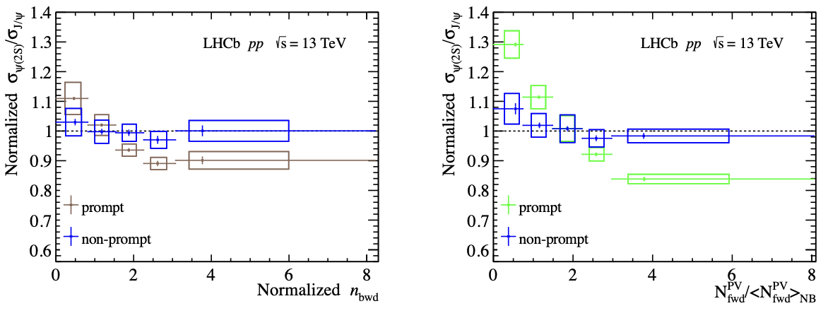
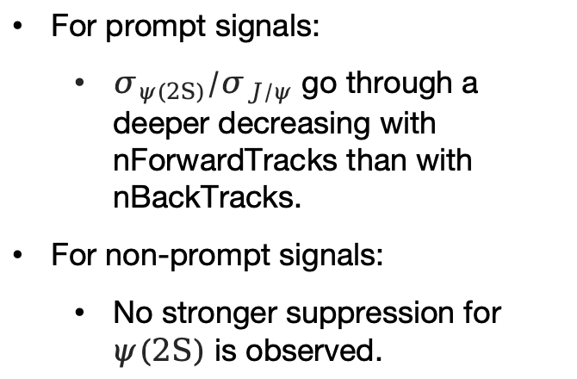
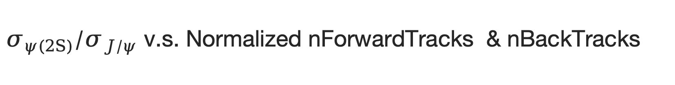
$σ_{ψ(2S)}/σ_{J/ψ}$ v.s. Normalized nForwardTracks & nBackTracks
Normalized $σ_{ψ(2S)}/σ_{J/ψ}$~ nForwardTracks and nBackTracks:
For prompt signals:
$σ_{ψ(2S)}/σ_{J/ψ}$ go through a deeper decreasing with nForwardTracks than with nBackTracks.
For non-prompt signals:
No stronger suppression for $ψ(2S)$ is observed.
nBackTracks is measured in: $−5.2<η<−1.5$
nForwardTracks is measured in: $1.5<η<5.2$
Notes:
We can see that the when we divide multiplicity classes by nBackTracks,
the decreasing trend for prompt production become moderate compared to the results with nForwardTtracks.
Which means the correlation due to the overlap of kinematic range where we measure the multiplicity and production do has an effect on the final results.
The rapidity range for where the nBackTracks is measured is minus five point two to minus one point five. And that for nForwardTracks is measured in one point five to five point two.
Yet, within uncertainties, no matter which variable we use to divide the multiplicity calsses, the ratio for non-prompt production doesn’t vary according to multiplicity.

Slide 17
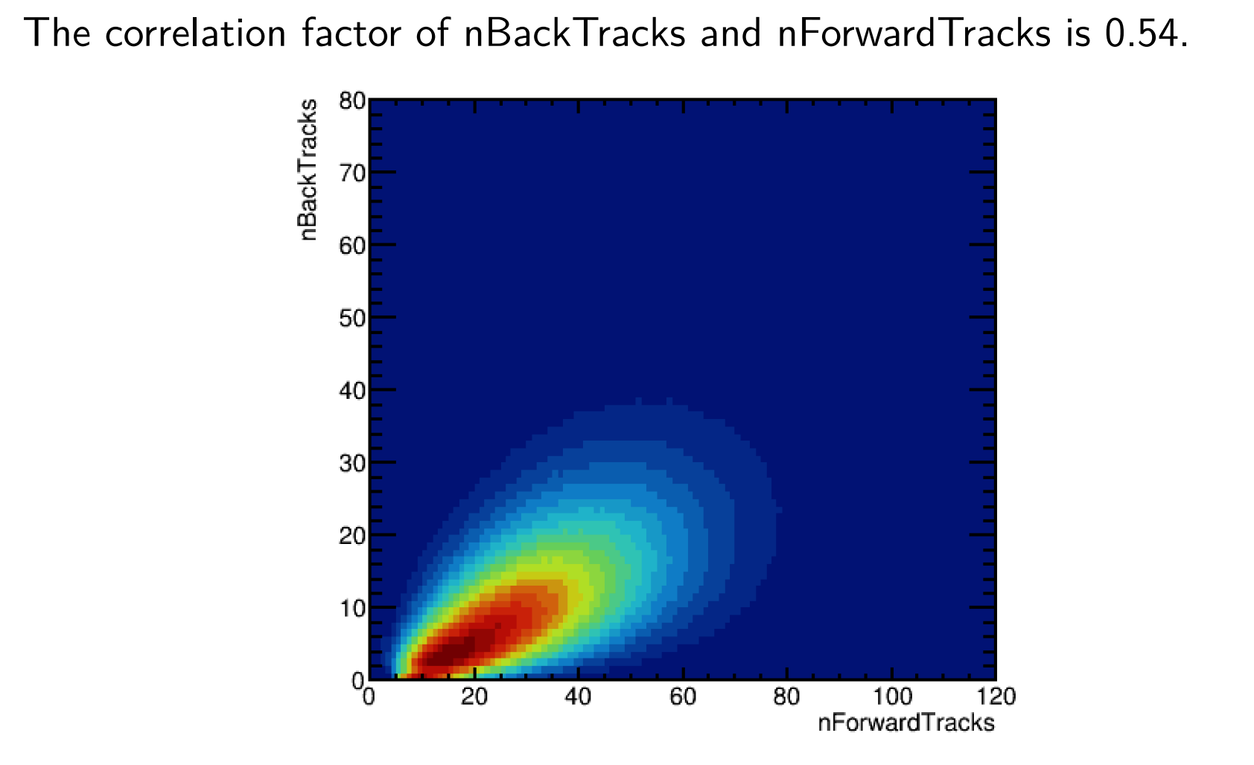
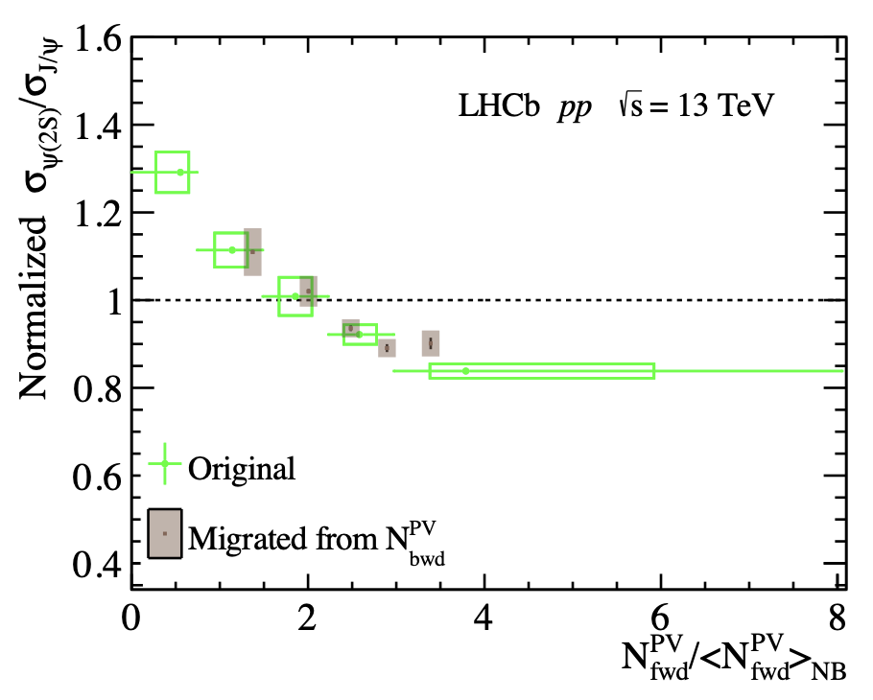
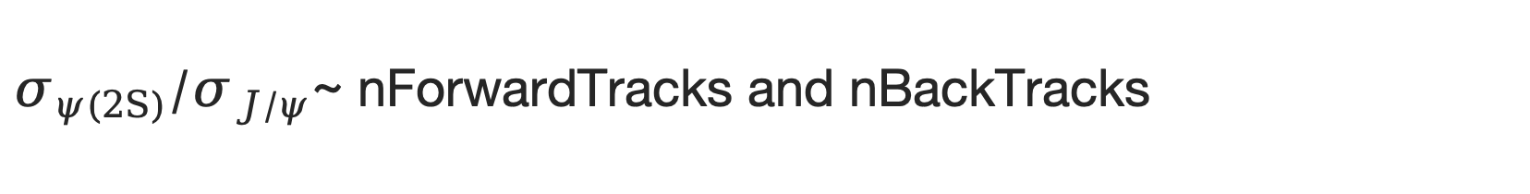
$σ_{ψ(2S)}/σ_{J/ψ}$~ nForwardTracks and nBackTracks
Results show that the suppression on ratio mainly result from the correlation of multiplicity and production measurements.
nForwardTracks v.s. nBackTracks, corr=0.54
Notes:
nBackTracks isn’t entirely independent, given a correlation of 0.54 for J/ψ and 0.51 for ψ(2S) with nForwardTracks. To check how large the correlation between nBackTracks and nForwardTracks will influence the ratio of production, we calculate the mean values of nForwardTracks in each nBackTracks bin, and migrate points to the nForwardTracks plot. Results show that the suppression on ratio mainly result from the correlation of multiplicity and production measurements.

Slide 18
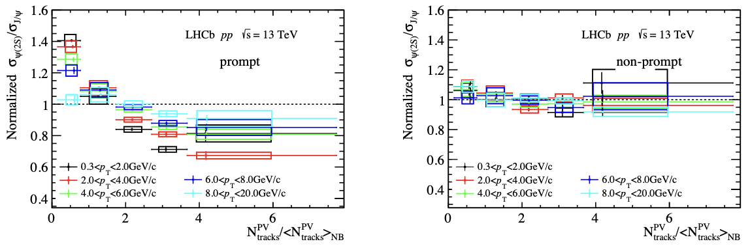
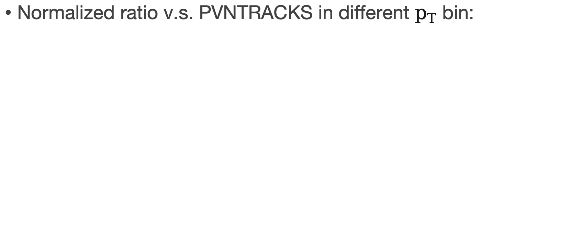

Result in different $p_{T}$ bin
Normalized ratio v.s. PVNTRACKS in different $p_{T}$ bin:
The decreasing trend gets slower, could result from less co-mover in high $p_{T}$ region.
Notes:
Finally we calculate the ratio in different pt bins and ybins.
We find that in high pt region, the ratio for prompt region becomes flat. The suppression become similar for both charmonia.
It may due to that there is less co-mover in high pT region.

Slide 19
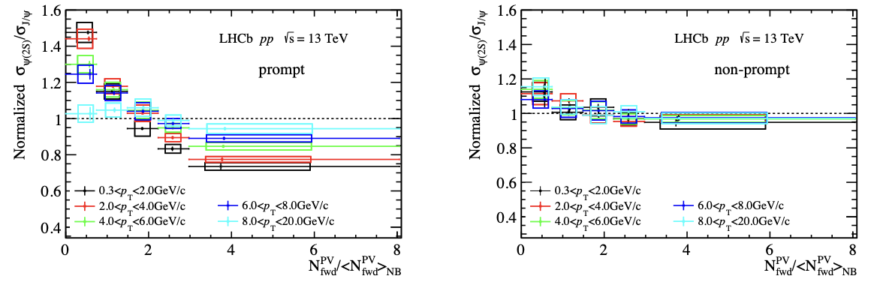
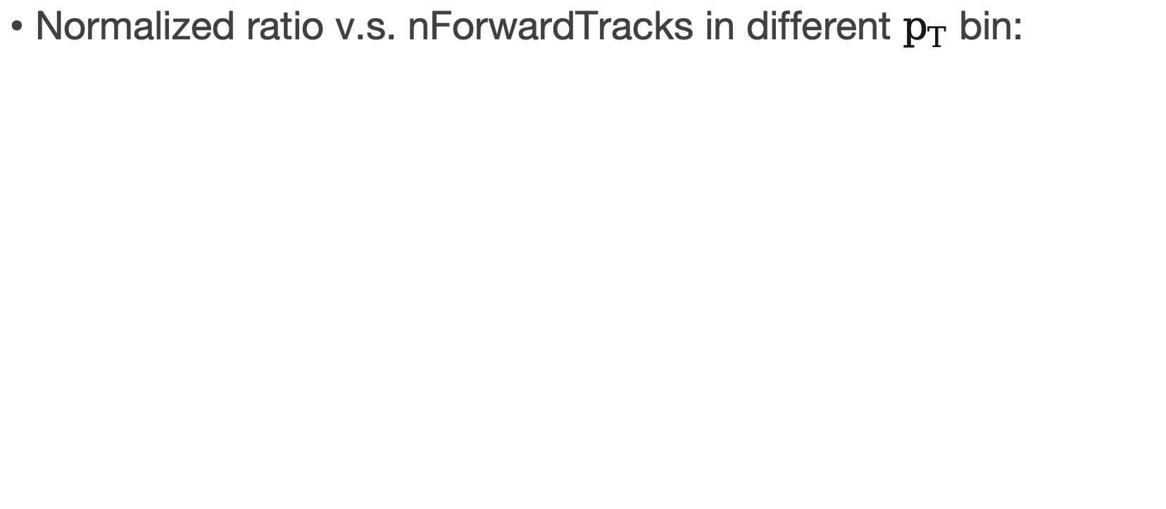
Result in different $p_{T}$ bin
Normalized ratio v.s. nForwardTracks in different $p_{T}$ bin:
The decreasing trend gets slower, could result from less co-mover in high $p_{T}$ region.
Notes:
Finally we calculate the ratio in different pt bins and ybins.
We find that in high pt region, the ratio for prompt region becomes flat. The suppression become similar for both charmonia.
It may due to that there is less co-mover in high pT region.

Slide 20
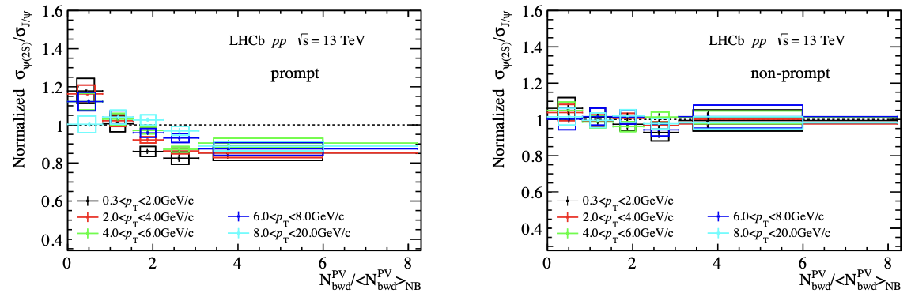
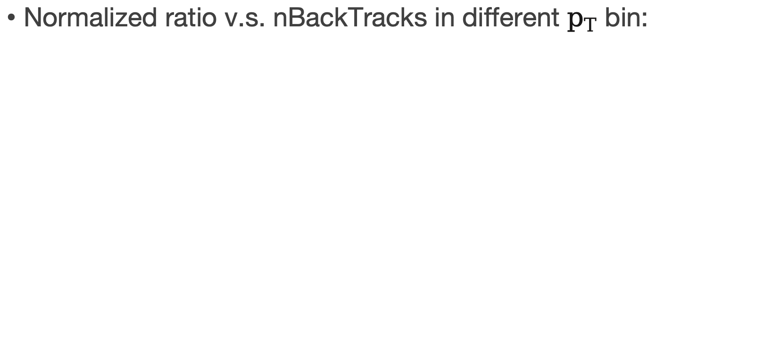
Result in different $p_{T}$ bin
Normalized ratio v.s. nBackTracks in different $p_{T}$ bin:
Notes:
Finally we calculate the ratio in different pt bins and ybins.
We find that in high pt region, the ratio for prompt region becomes flat. The suppression become similar for both charmonia.
It may due to that there is less co-mover in high pT region.

Slide 21
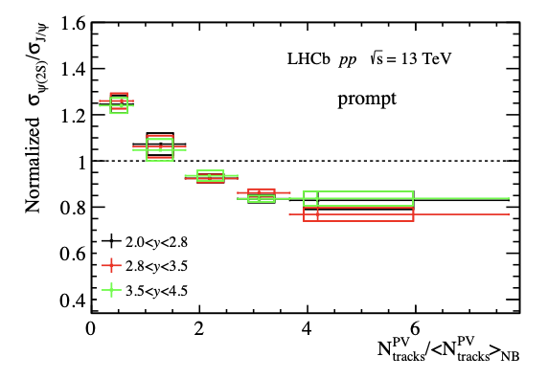
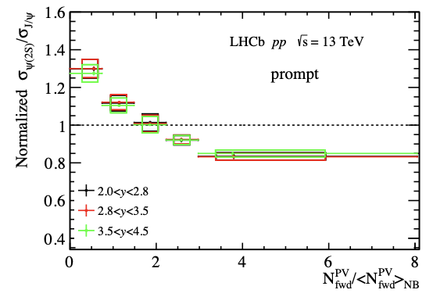
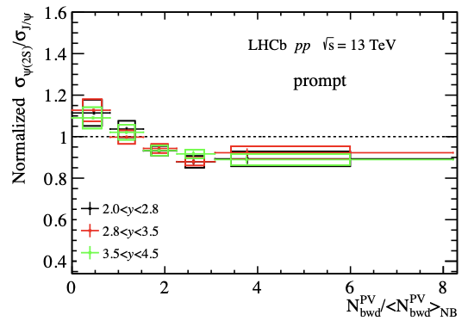
Result in different rapidity bin
Ratio of prompt production as function of multiplicity in different rapidity bin:
The suppressions for both charmonia in different rapidity region are almost the same.
Notes:
And the result in different rapidity bins seems quite the the same.

Slide 22
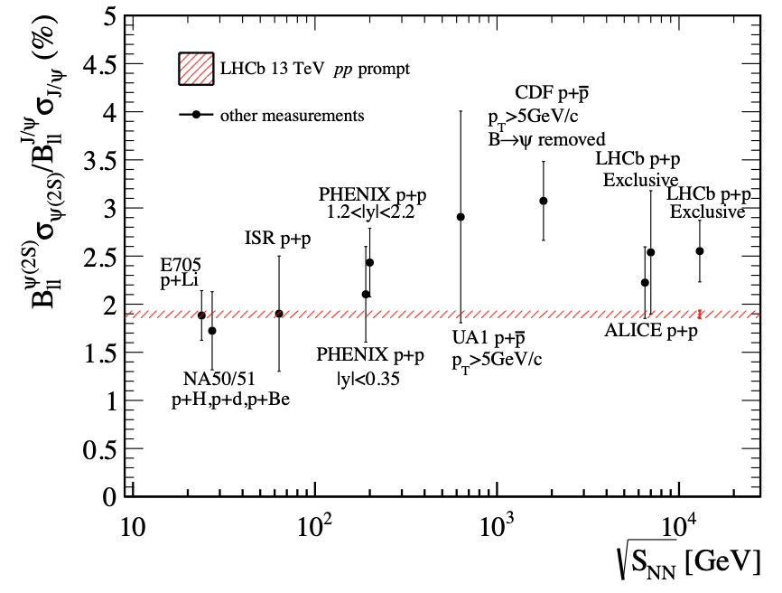
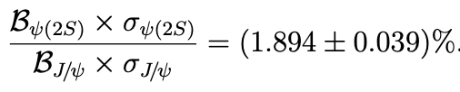
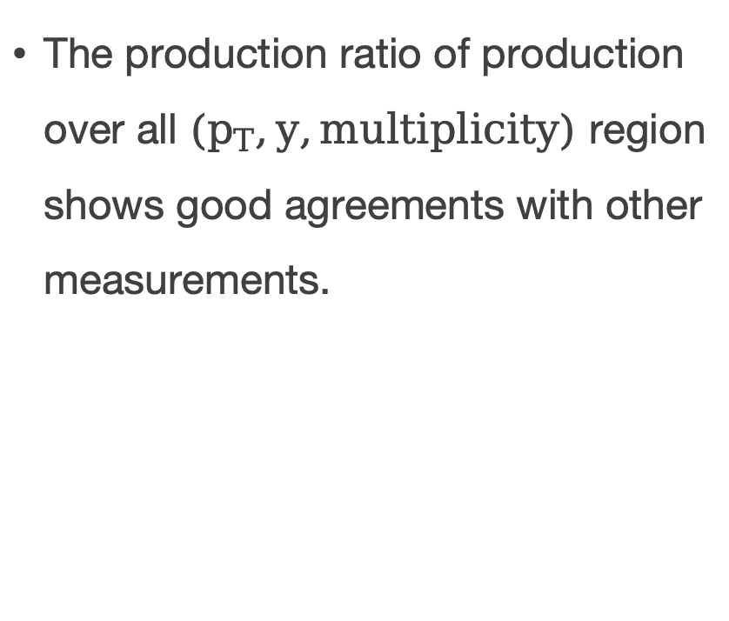
Comparison to world data
The production ratio of production over all $(p_{T},y,multiplicity)$ region shows good agreements with other measurements.

Slide 23
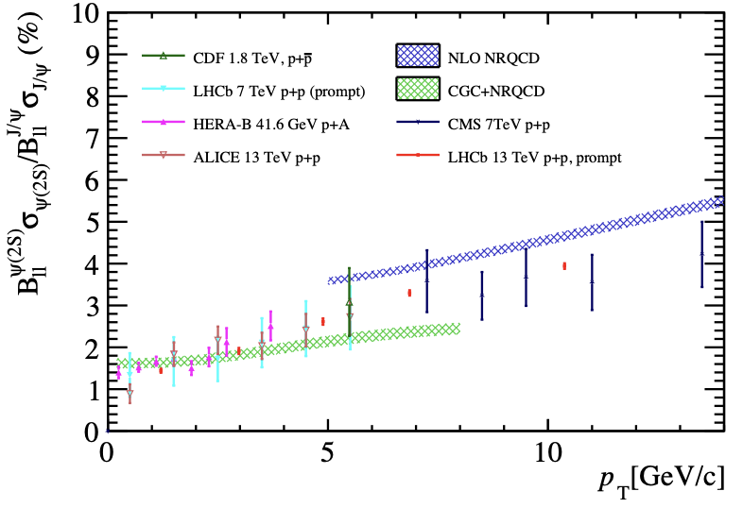
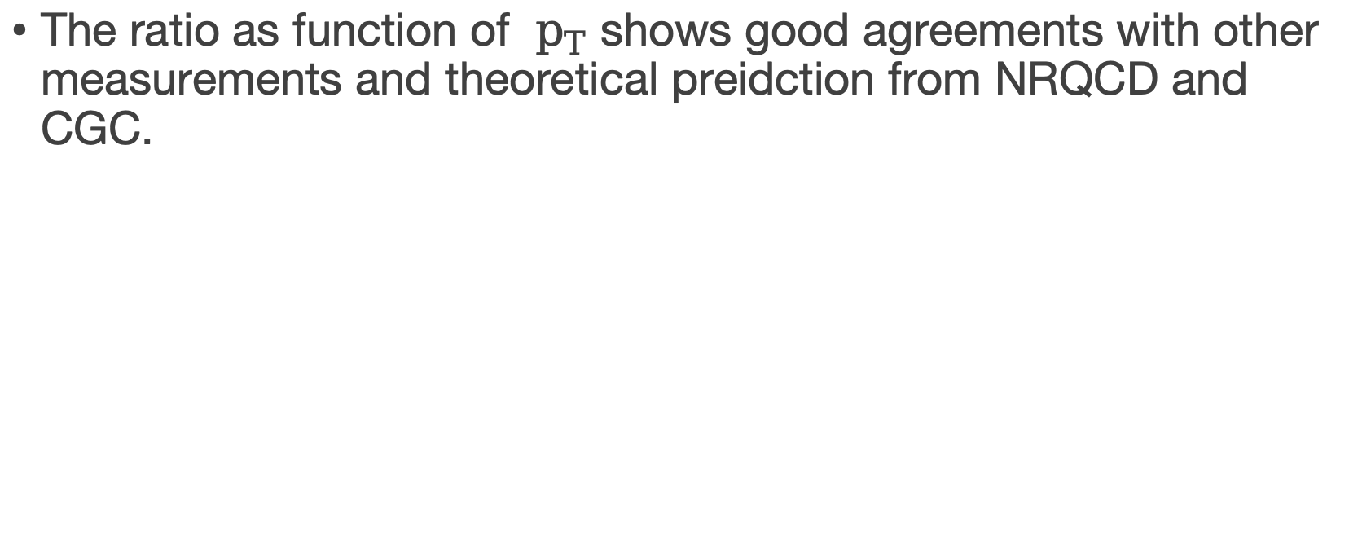
Comparison to world data
The ratio as function of $p_{T}$ shows good agreements with other measurements and theoretical preidction from NRQCD and CGC.
Notes:
contact

Slide 24
Thanks for listening!

Slide 25
Back Up

Slide 26
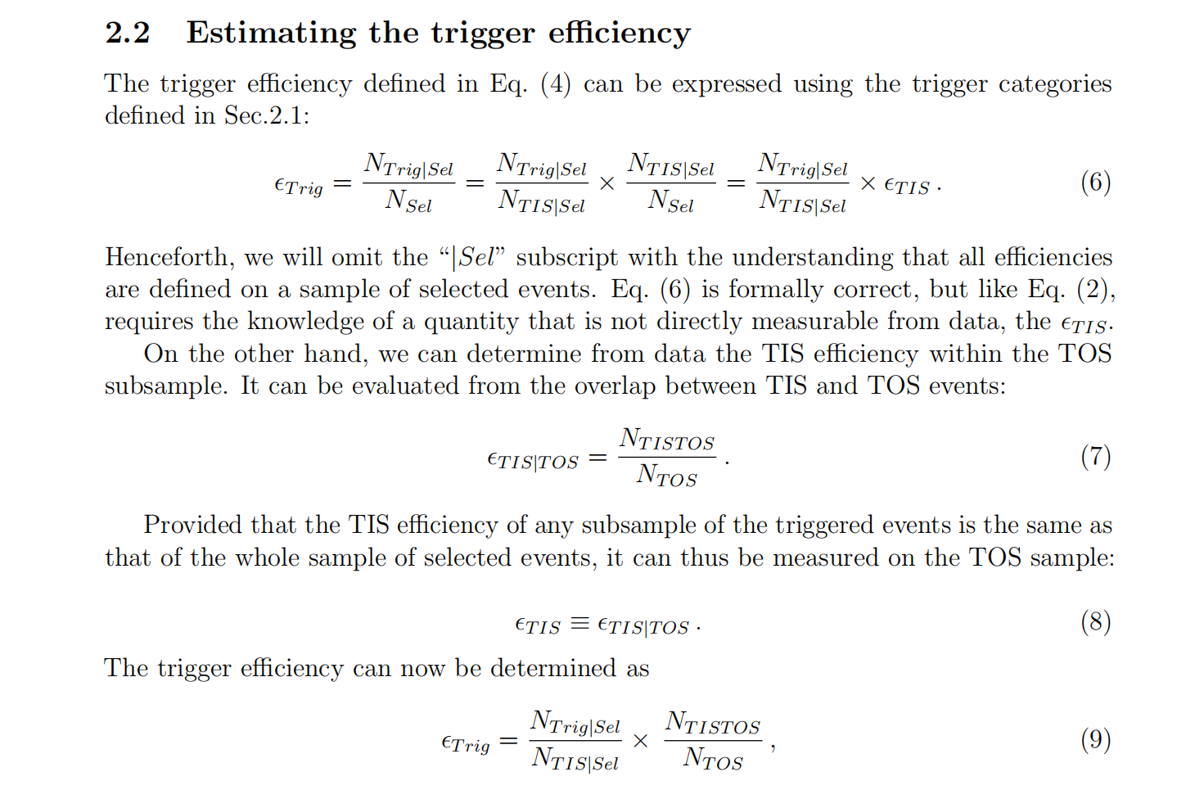
TISTOS method
LHCb-PUB-2014-039
Notes:
The point of TISTOS method is we determine the TIS efficiency with TOS subsample. Because we can not know the true TIS efficiency since only triggered events will be recorded. The detailed derivation can be seen in this article.

Slide 27
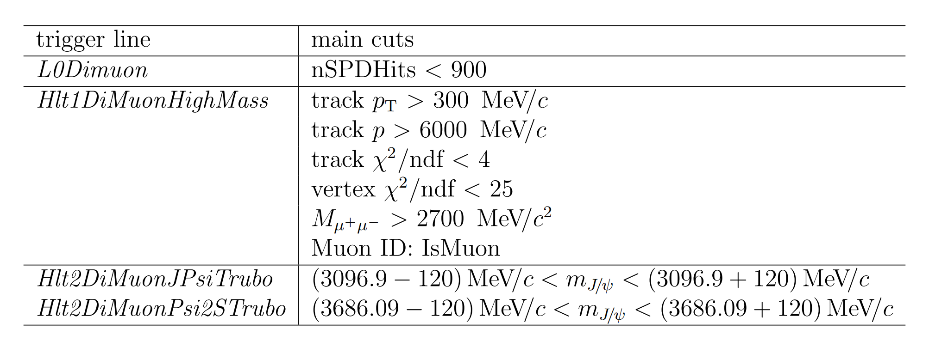
Trigger Line Cut

Slide 28
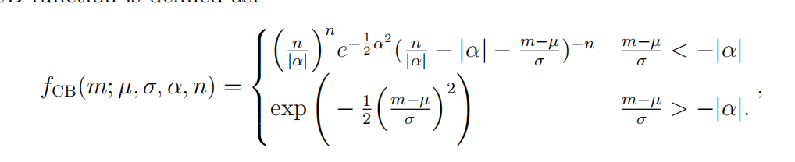
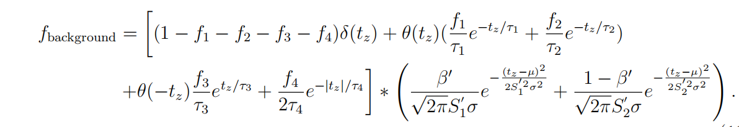
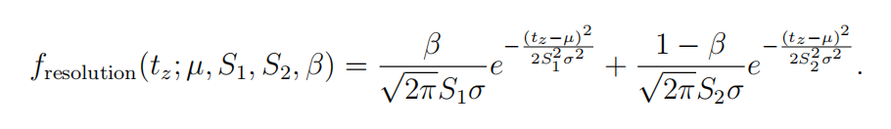
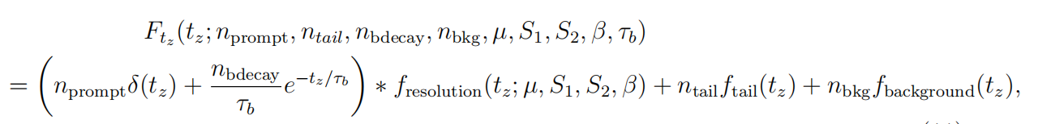
Formula for fit pdf

Slide 29
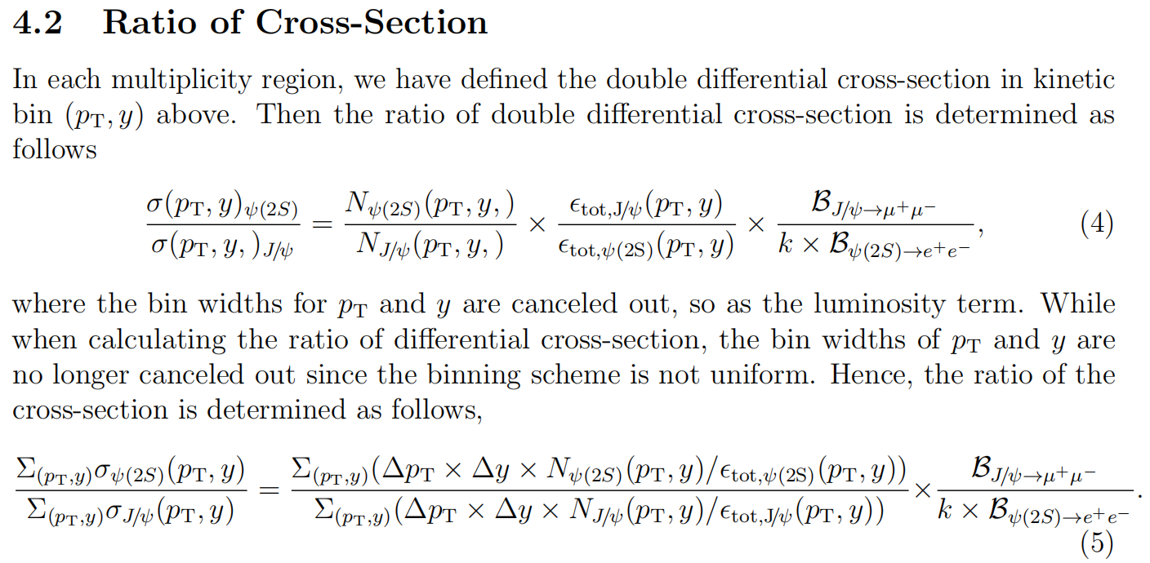
Cross section determination

Slide 30
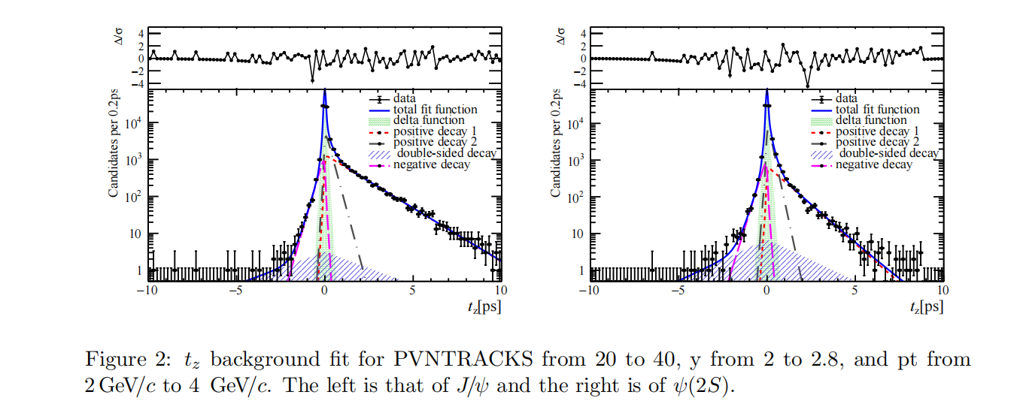
Background fit
sideband sample: at least 60MeV from the center of the mass

Slide 31

certer of bin
Notes:
the distributions of multiplicity skew a lot so that in a certain bin,
the center of the bin may not represent an ideal horizontal coordinate for plotting the
results, especially for the small and large multiplicity regions. To study the effect, 10000
fitting trials are done in Monte Carlo. In each trial, in a certain multiplicity region of the
three different binning schemes (PVNTRACKS, nForwardTracks, and nBackTracks), we
randomly sample the mean values of the multiplicity region from a Gaussian sampling,
within each bin, mean being the content of the bin and width being the error of the bin.
fit. Since the data point is a ratio between two species, J/ψ, and ψ(2S), the average value for the ratio is weighted by the inverse of the square of the uncertainties (following the PDG weighted average procedure).

Slide 32
Correlation back&Forward

Slide 33

Long tag&probe method

Slide 34

Efficiency
PIDCalib package
Notes:
Then the production is corrected by efficiency.
Where the total efficiency consist of four parts.
The geometrical acceptance,
reconstruction and selection efficiency.
And the Muon ID efficiency is obtained using simulated samples calibrated with the data using the PIDCalib package.
And finally the trigger efficiency.
Below is the difinition for efficiencies of all kind.

Slide 35


high-, low-multiplicity pt-y reweight

